Slide 1
Electronic communications services: Ensuring equivalence in access and choice for disabled end-users - Article 23a
ERG/BEREC Project
Public Hearing, Brussels 19 November, 2010

Slide 2
Introduction

Slide 3
Objective of today’s meeting
To explain the scope and purpose of BEREC’s consultation
To provide a summary of the main points of the paper
To highlight the questions that BEREC is seeking inputs from stakeholders on
To facilitate questions & comments from stakeholders

Slide 4
Scope of the Consultation - Article 23a
The 2009 Universal Service Directive (USD), contains a new Article, (Article 23a), entitled ‘Ensuring equivalence in access and choice for disabled end-users’.
Article 23a contains two sections;
Section 1 relates to equivalent access and choice for disabled end-users and;
Section 2 relates to encouraging the availability of terminal equipment.

Slide 5
Purpose of BEREC’s consultation paper
To provide enhanced input for NRAs who may be responsible for implementing the provisions of Article 23a and therefore will need to (on a national Level);
Collate information regarding the needs of electronic communications end-users with disabilities with respect to equivalent access and choice;
Assess whether or not access and choice for end-users with disabilities is equivalent;
Identify and implement measures to address issues identified with respect to ensuring equivalent access and choice; and
Ensure that obligations placed on service providers are proportionate to the objectives.

Slide 6
Purpose of BEREC’s consultation paper
The consultation paper
presents information collated from NRAs regarding the current measures in place in MS;
presents the preliminary views of NRAs with respect to assessing and implementing equivalent access and choice, and
seeks the views of interested parties including consumers, end-users with disabilities, representative organisations, and service providers.

Slide 7
Structure of the consultation paper
Introduction
Background to and purpose of Article 23a
Current legal framework and measures in place in MS with respect to accessibility
Based on information available to and provided by NRAs
Equivalent access and choice; factors for consideration
Based on preliminary views provided by NRAs
Services and features available for end-users with disabilities
Based on information available to and provided by NRAs
Proposed approach to achieve equivalent access and choice
Based on factors above and legislative scope

Slide 8
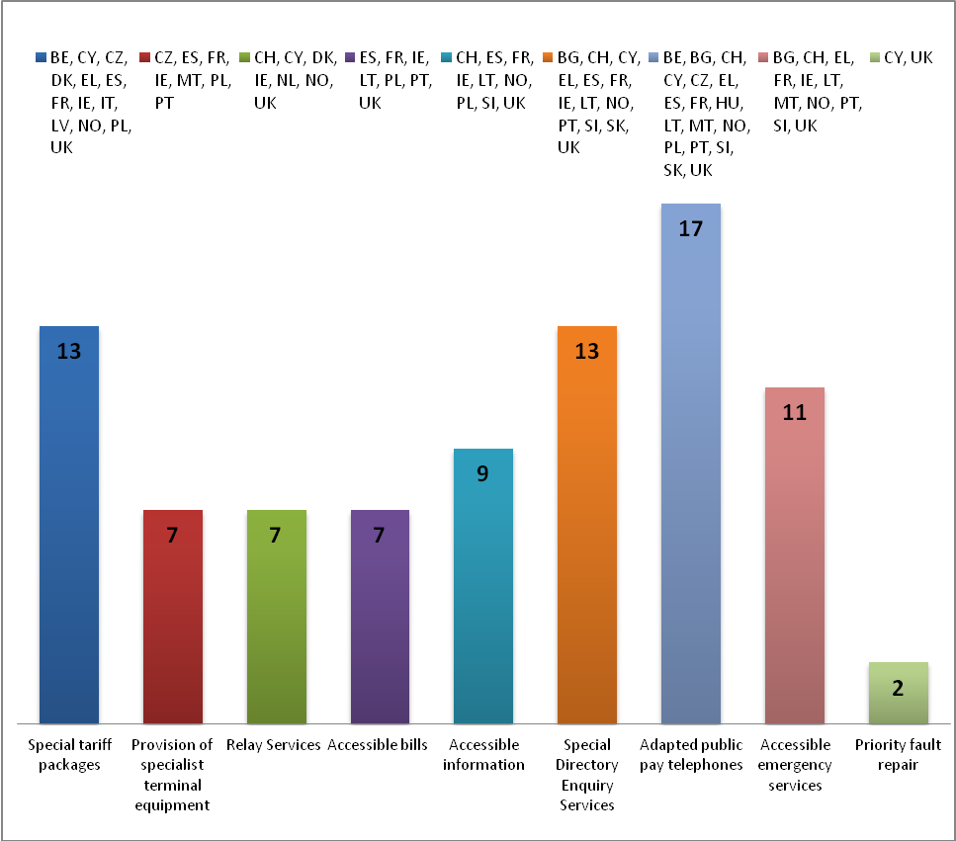
Current measures in place in MS with respect to accessibility

Slide 9
Equivalent access
Important considerations
the user’s capacity to access and use the electronic communications service in an equivalent way to other end-users;
the user’s capacity to access and use services associated with the use of an electronic communications service in an equivalent way to other end-users.

Slide 10
Equivalent Access - User’s capacity to access and use the service in an equivalent way

Slide 11
Equivalent Access - User’s capacity to access and use associated services in an equivalent way

Slide 12
Equivalent choice
Important considerations
having a range of service providers that provide accessible services to choose from;
being able to exercise their choice.

Slide 13
Equivalent Choice - range of service providers that provide accessible services

Slide 14
Equivalent Choice - being able to exercise choice.

Slide 15
Encouraging availability of terminal equipment – what could NRA’s do?

Slide 16
Proposed Approach
At a national level;
Determination of factors to assess equivalent access & choice;
Assess each factor for end-users with disabilities and other end-users;
Identify proportionate measures to address issues with respect to equivalence;
Consult with interest parties regarding proposed measures and obligations on undertakings.

Slide 17
Consultation Questions
Legal Provisions
Factors for assessing equivalent access and choice
Placing obligations on service providers
Information provided to end-users with disabilities
Encouraging availability of terminal equipment
Services and features
Costs
Proposed approach for NRAs

Slide 18
Next Steps
Consultation closes 26 November 2010
BEREC will consider all stakeholder views
Present report, revised as relevant, to Plenary in February 2011
Publish final report and stakeholder inputs

Slide 19
Views?

